Slide 1
Intro to DS -Premalatha T

Slide 2
Agenda
Types of Analytics
Steps in a ML Project
Supervised and Unsupervised Learning
Regression and Classification

Slide 3










Types of Analytics
Descriptive
Diagnostic
Predictive
Prescriptive

Slide 4

























Slide 5









Slide 6
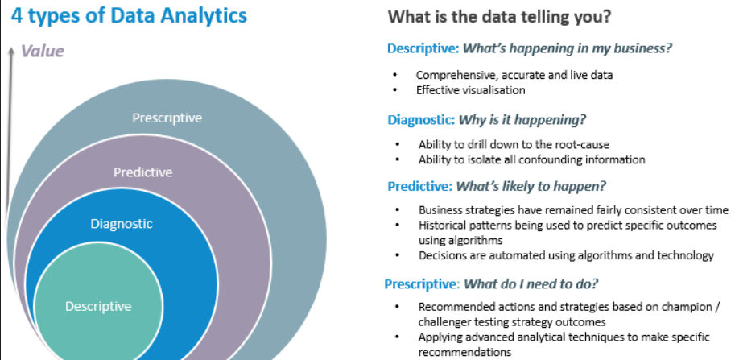

Slide 7














Slide 8
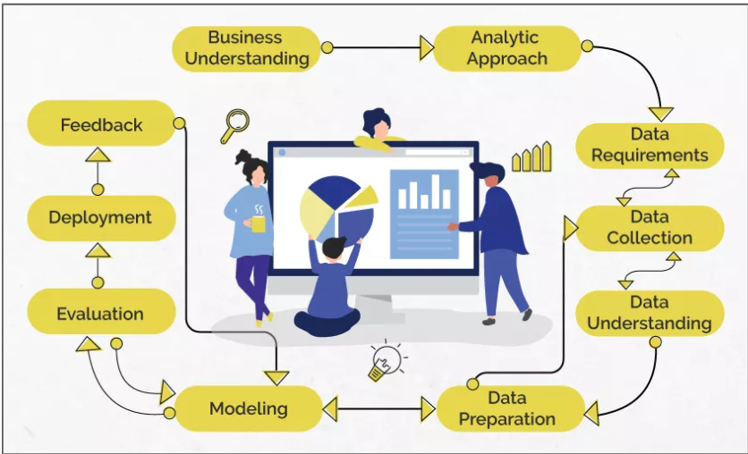









Data Science

Slide 9
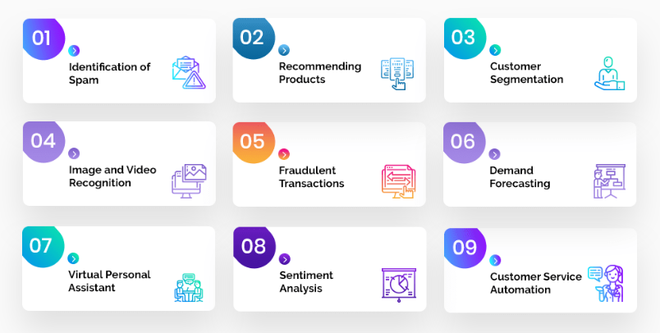


Problem Statement

Slide 10
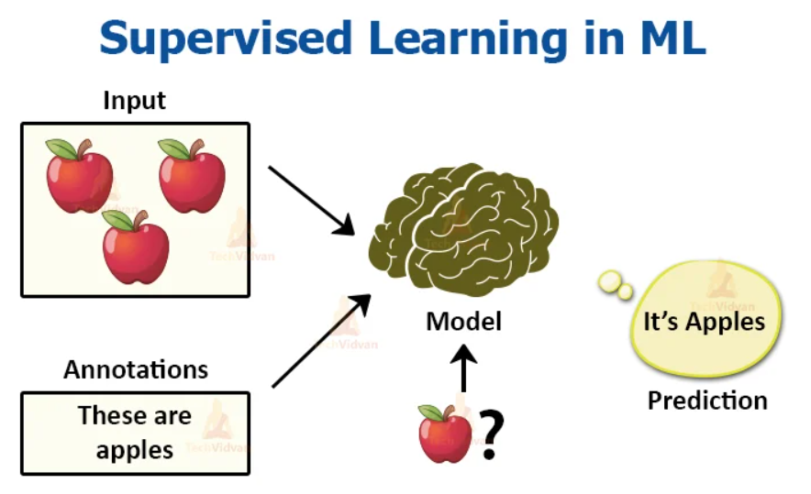






Analytic Approach

Slide 11



















Slide 12
















Slide 13













































Slide 14





















Slide 15































Slide 16





























Slide 17




















Slide 18



















Slide 19





















Slide 20


Slide 21
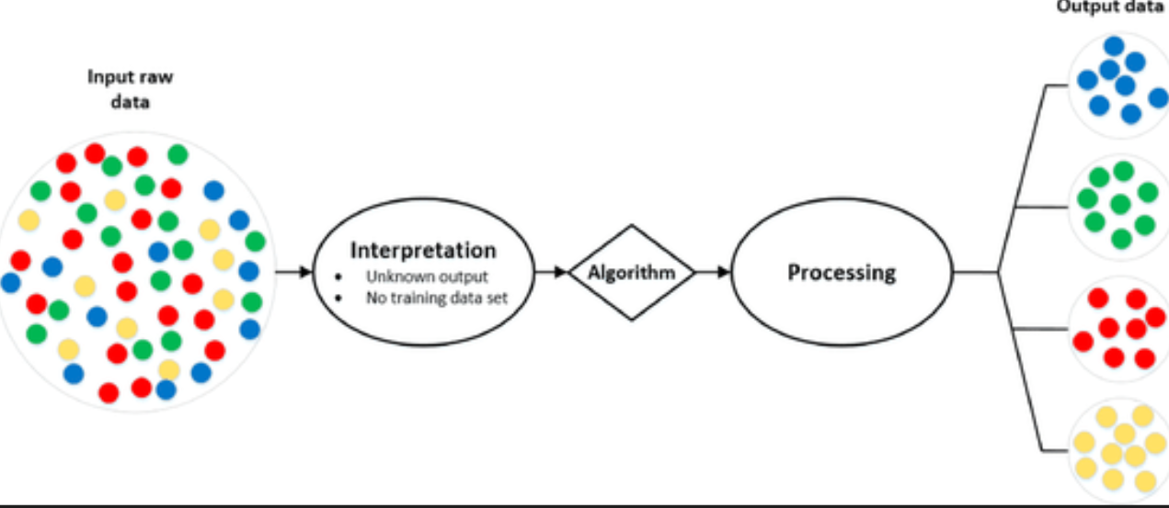
Analytic Approach

Slide 22
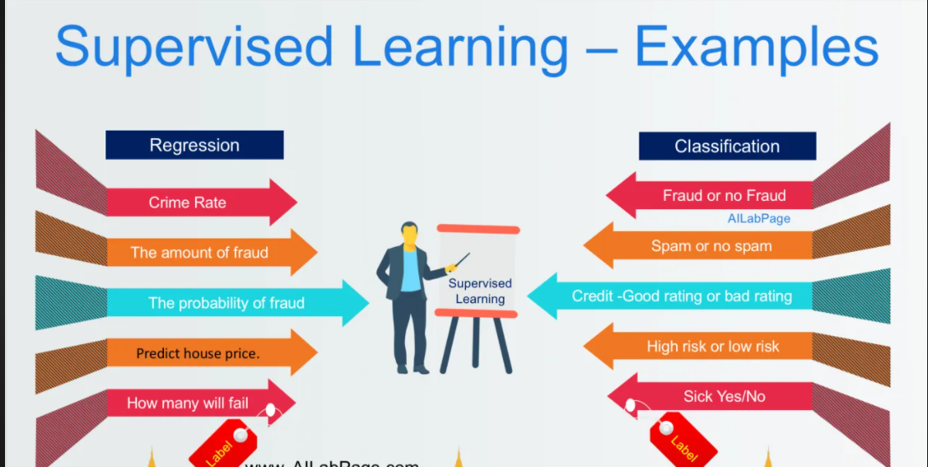
Supervised Learning

Slide 23
Machine Learning
Supervised Learning
Unsupervised Learning

Slide 24
Data understanding
Qualitative
Quantitative
Discrete
Continuous
Categorical
Ordinal

Slide 25
Data preparation
Missing Values
Outliers
Handling Categorical variables
Redundancy in data

Slide 26
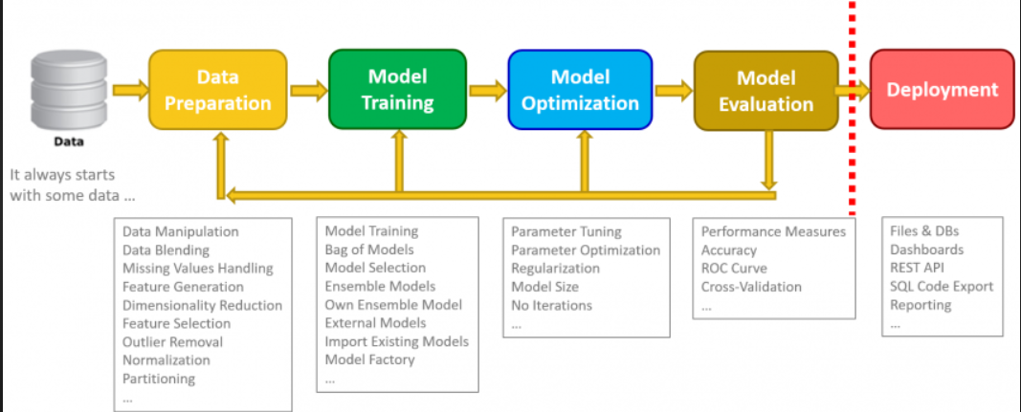
Data Science

Slide 27
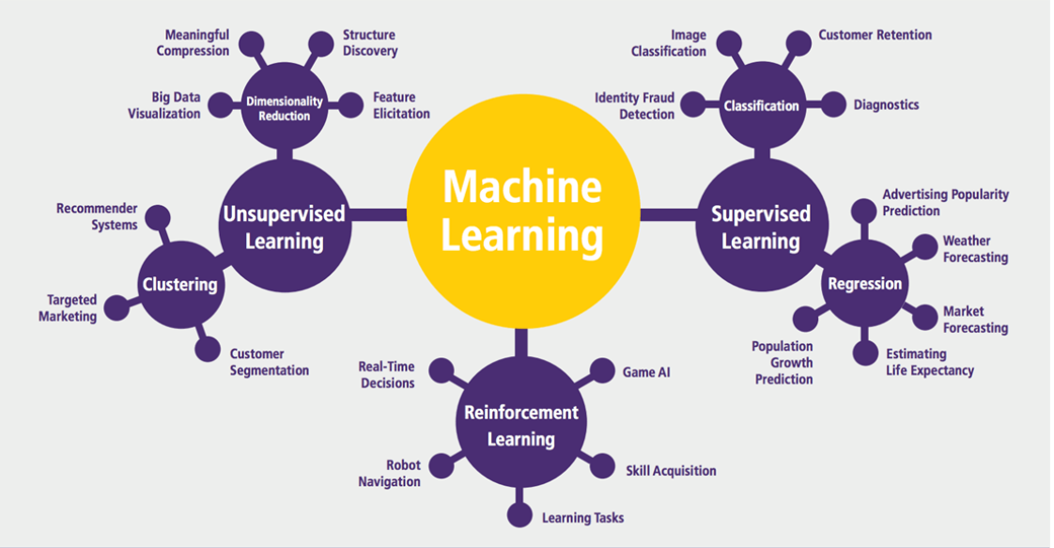
Machine Learning

Slide 28
Applications in Manufacturing
Price Optimization
Predictive Analytics
Demand Forecasting and Inventory Management
Supply Chain Management

Slide 29
Applications in Retail and E-Commerce
Market Basket Analysis
Warranty analytics
Price Optimization
Inventory Management
Location of new stores
Customer sentiment analysis

Slide 30
Applications in Education
Improve Adaptive Learning
Better Assessment of Teachers
Improve Student’s Performance
Better Parent Involvement

Slide 31
Other Applications
Agriculture
Customer Service
Airline Route Planning
Product Recommendation Systems
Digital marketing and Advertising
Internet Search

Slide 32
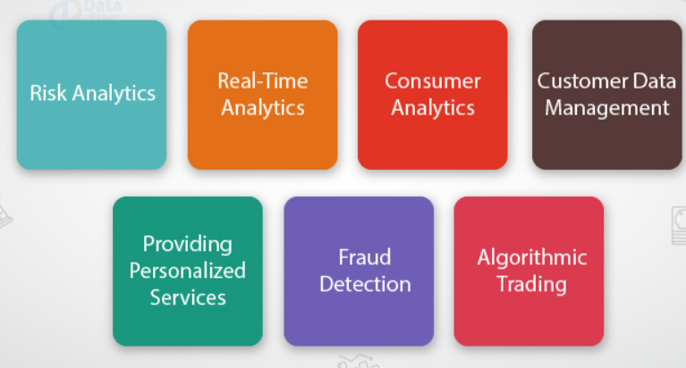
Applications in Finance

Slide 33
Career opportunities
Business Intelligence Analyst
Data Analyst
Data Scientist
Data Engineer
Quantitative Analyst
Data Analytics Consultant
Operations Analyst
Marketing Analyst
Transportation Logistics Specialist
Big data Engineer
Artificial Intelligence researcher
Machine Learning Engineer
Research Scientist
AI Data Analyst
AI Engineer
Robotics Scientist

Slide 34
Questions ????

Slide 35
Statistics -> Descriptive Inferential
Collect
Organize
Analyse
Present Data

Slide 36
Election-> Which party will win this election?
1M -> eligible to vote -> Population
Sampling -> 500 -> sample
Based upon the sample I am inferring about the Population
(95%)

Slide 37
Measures of central tendency
Mean
Median
Mode
3 M’s

Slide 38













Slide 39














Slide 40


















Slide 41













Slide 42













Slide 43





















Slide 44
Measures of Dispersion
Variance
Std
Range
Quartiles

Slide 45






Slide 46


















Slide 47






















Slide 48







Slide 49









Slide 50









Slide 51






Slide 52




















Slide 53






